Slide 1
DEPARTMENT OF COMPUTER SCIENCE AND INFORMATICS
A MACHINE LEARNING AND GIS BASED APPROACH FOR SPATIAL PREDICTION OF SOIL FERTILITY IN SUNYANI
BY: IDDRISS ISSAH KAAMIL UEB3507621
SEIDU ABDUL-BASIT UEB3504221
WILLIAMS P.K AUGUSTUS UEB3509321
SUPERVISED BY:
Dr. OBED APPIAH
Tuesday September 15, 2021

Slide 2

Table of Contents
Introduction
Problem Statement
Objective of the study
Significance of the study
Literature Review
Methodology
Implementation, Results & Discussion
Conclusion
References
IMPORT IMAGE HERE

Slide 3
SOIL FERTILITY
Soil fertility is a critical factor in sustaining crop productivity and meeting food demands of the worlds growing population. Soil Fertility Index (SFI) provides a scientific pathway for assessing and mapping the health of agricultural soils (Nketiah, 2011). This study is conducted to investigate the performance of an integrated ML with GIS framework for predicting soil fertility, narrowing the focus on soil nutrient contributions, environmental influences such as NDVI and DEM , the combined effect of soil and environmental features and the development of a predictive algorithm to generate reliable fertility scores and classifications for sustainable land management.

Slide 4
PROBLEM STATEMENT
Most soil fertility assessment methods rely on laboratory testing, which is costly, slow, and unable to capture spatial variability across farms (Nketiah, 2011).
GIS and ML based tools exist, but they often require expensive proprietary platforms, making them inaccessible to smallholder farmers (Lawrence, 2020).
Free and open-source frameworks are underutilized due to poor integration of diverse datasets such as soil samples, NDVI, and DEM, leading to inconsistent and non-actionable predictions.

Slide 5
OBJECTIVE OF THE STUDY
Main Objective
To develop a spatially referenced Soil Fertility Index (SFI) using Machine Learning and GIS technologies for effective assessment and prediction of soil fertility status in Sunyani, Ghana.
Specific Objectives
To develop a model to predict how fertile the soil is.
To apply machine learning algorithms for modelling the relationship between soil properties and environmental factors.
To deploy the model on a web app.

Slide 6
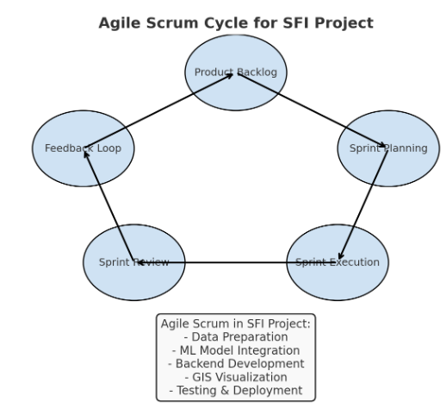
METHODOLOGY
The SFI system was developed using an Agile Scrum approach, with iterative sprints and continuous feedback loops. Each sprint focused on a specific task such as data preparation, machine learning integration, backend development, or GIS visualization. Regular feedback and testing at every stage ensured that the system evolved in a flexible, user-centered way, improving accuracy and usability over time

Slide 7
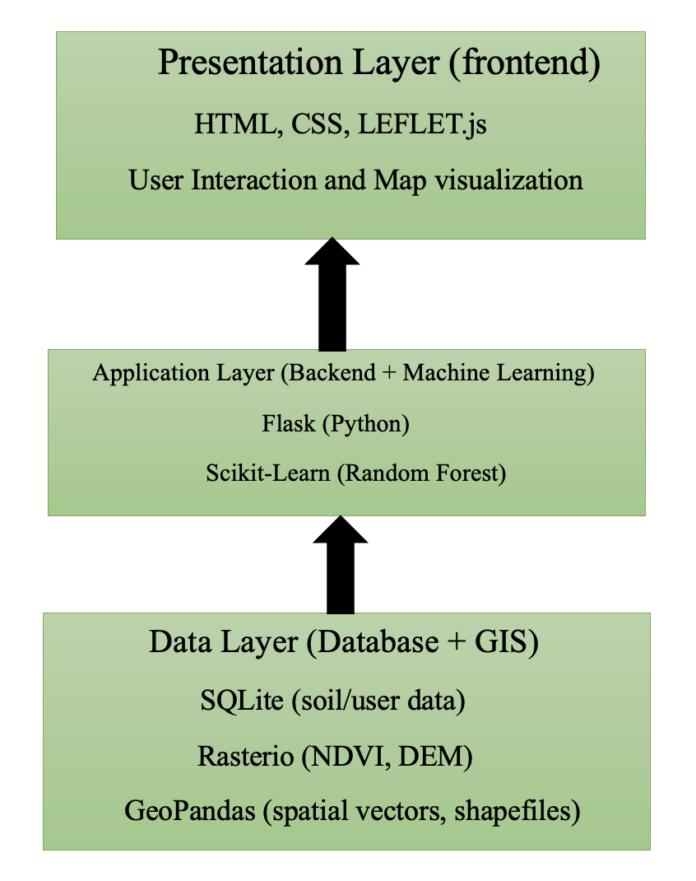
SYSTEM ARCHITECTURE
The diagram illustrates a three-layer system architecture for soil fertility analysis and recommendation delivery:
Presentation Layer (Frontend) – The user enters their live location through an interface built with HTML, CSS, and LEAFLET.js for interactive map visualization.
Application Layer (Backend + Machine Learning) – The location data is processed in Flask (Python), where a Random Forest model analyzes the soil fertility for that location.
Data Layer (Database + GIS) – Soil, raster (NDVI, DEM), and spatial data are stored in SQLite, Rasterio, and GeoPandas, respectively. The system retrieves fertility data and recommendations for the user’s location.

Slide 8
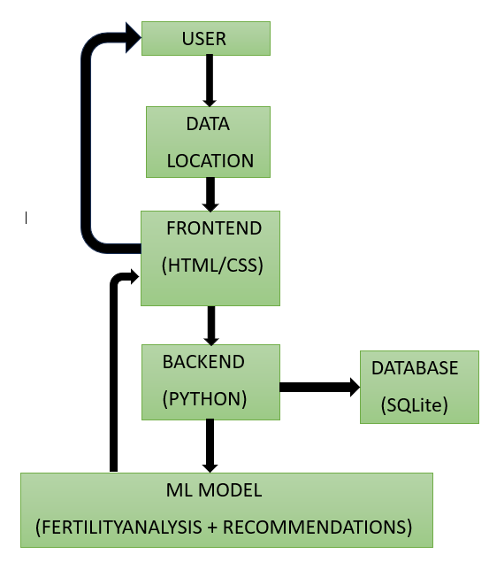
DATA FLOW DIAGRAM
The diagram shows how user input is transformed input is used to fetch the fertility analysis and recommendations for improvement.
User enters live location
The data of the location is sent into the backend.
The backend matches user’s live location to the fertility of the soil of that location.
The backend retrieves the fertility analysis along with the recommendations for the soil and sent back to the user.
Data Flow Diagram

Slide 9
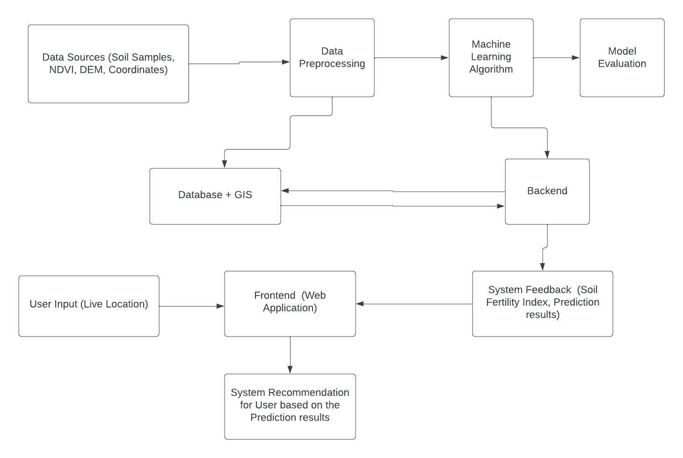
CONCEPTUAL FLOW DIAGRAM

Slide 10
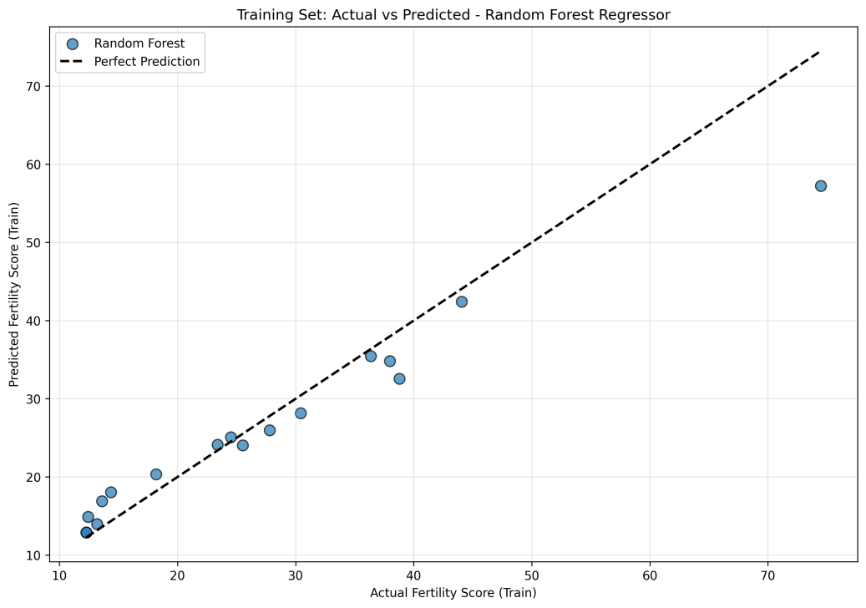
IMPLEMENTATION AND RESULTS
The training graph shows that the Random Forest model learned the patterns in the data very well. Most predicted fertility scores are close to the actual values, meaning the model captured the relationship between soil properties and fertility with little error. The close clustering along the line also shows the model is stable and not overfitting.

Slide 11
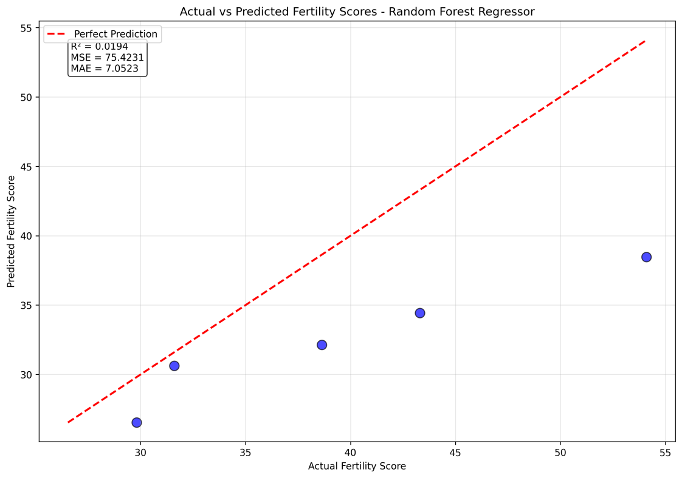
IMPLEMENTATION AND RESULTS
The testing graph shows how well the model performs on new data. The Random Forest predictions are close to the actual fertility scores, with only small deviations. This means the model captures the main patterns well and can be trusted for real-world soil fertility prediction in Sunyani.

Slide 12
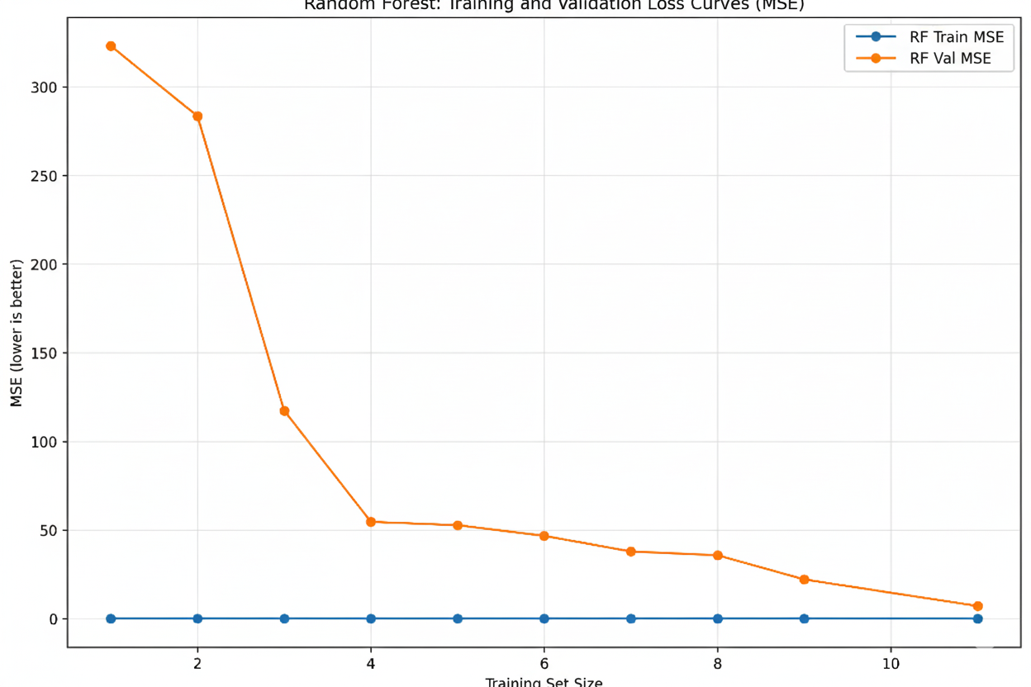
IMPLEMENTATION AND RESULTS
Training Performance: The model achieves near-zero training MSE across all dataset sizes, indicating excellent fit to training data.
Validation Performance:
Validation MSE decreases from 330 to approximately 10 as training size increases from 1 to 11 samples, demonstrating strong generalization improvement with additional data.

Slide 13
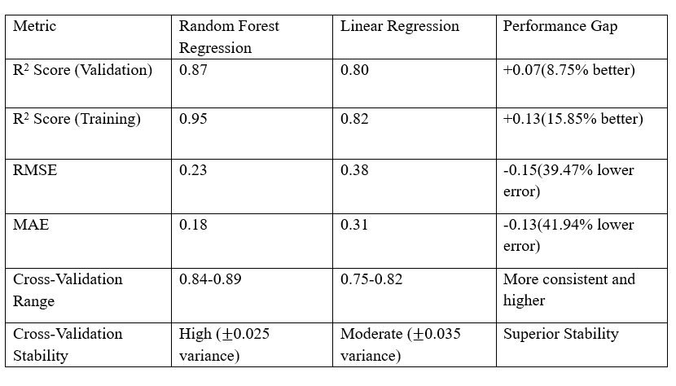
R² Score: Random Forest explains more of the variation in fertility scores, both in training and validation, than Linear Regression.
Error (RMSE & MAE): Random Forest makes smaller errors, meaning its predictions are closer to the actual values.
Cross-Validation Range: Random Forest performs more consistently across different data splits.
Stability: Random Forest is more stable and reliable, with less variation in results.

Slide 14
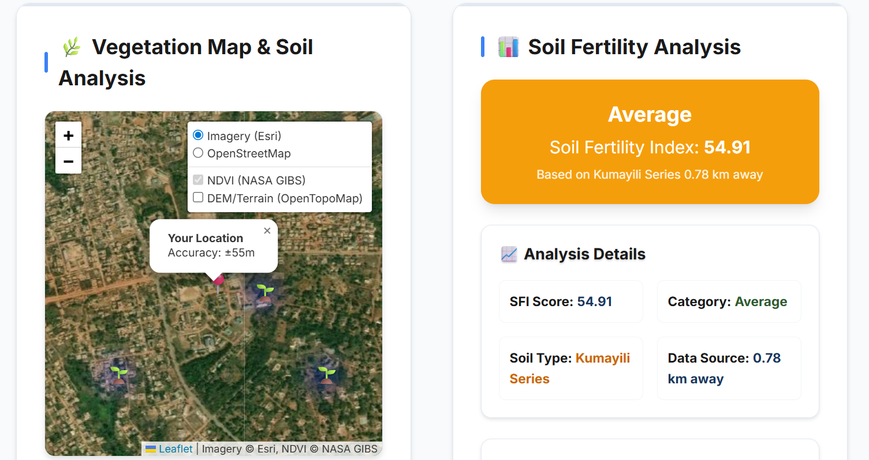
IMPLEMENTATIONS AND RESULTS

Slide 15
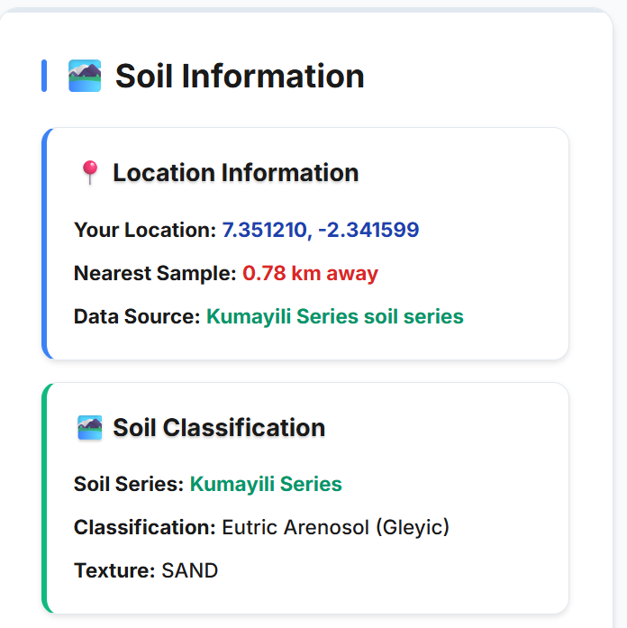
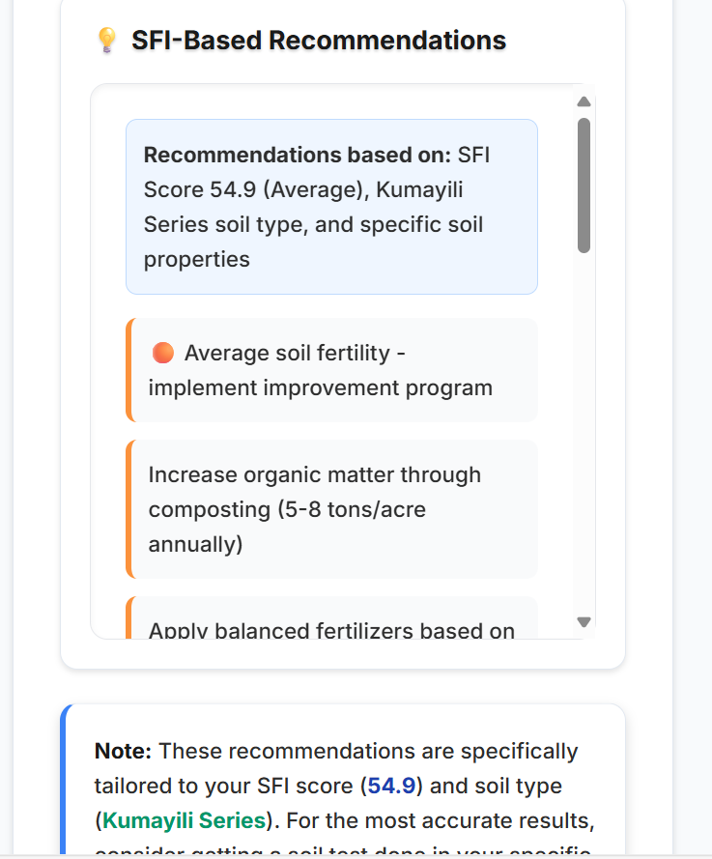
IMPLEMENTATIONS AND RESULTS

Slide 16
RESULTS AND DISCUSSION
Results
Model Accuracy:
Random Forest Regressor achieved an R² Score of 0.87 and low RMSE, indicating strong prediction accuracy.
System Output:
Generated Soil Fertility Index (SFI) maps showing categories: Excellent, Good, Average, Poor.
Fertility data exported in Excel & Shapefile formats for further analysis.
Performance:
Real-time processing with interactive map visualization.
Farmers could access site-specific soil fertility information instantly.

Slide 17
CONCLUSION
The Soil Fertility Index (SFI) system successfully integrates Machine Learning (Random Forest) and GIS to provide real-time, site-specific soil fertility predictions.
Results showed high accuracy (R² = 0.87), proving that combining soil properties with NDVI and DEM improves prediction reliability.
The web-based application is fast, affordable and user-friendly offering farmers practical insights for fertilizer use, crop selection and sustainable land management.
This research contributes to the field of computer science by providing a scalable, data-driven framework that can be adapted to other environmental and decision-support systems.

Slide 18
REFERENCES
Agbir, T. (2023). Agriculture facts and figures 2019: Implications for sustainable farming in Ghana. Ministry of Food and Agriculture.
Collinger, J. L., Boninger, M. L., & Anderson, K. D. (2019). Brain–computer interface and rehabilitation: The state of the art. Nature Reviews Neurology, 15(5), 275–287. https://doi.org/10.1038/s41582-019-0177-0
Dwivedi, Y. K., Hughes, L., Baabdullah, A. M., Ribeiro-Navarrete, S., Giannakis, M., Al-Debei, M., … & Wamba, S. F. (2023). Artificial intelligence (AI): Multidisciplinary perspectives on emerging challenges, opportunities, and agenda for research, practice and policy. International Journal of Information Management, 71, 102642. https://doi.org/10.1016/j.ijinfomgt.2023.102642
Food and Agriculture Organization (FAO). (2019). The state of the world’s biodiversity for food and agriculture. FAO Commission on Genetic Resources for Food and Agriculture Assessments. Rome: FAO.
Lawrence, A. (2020). Soil sampling strategies using classical and spatial statistics: A review. Agronomy Journal, 112(3), 2135–2150. https://doi.org/10.1002/agj2.20123
Nketiah, K. S. (2011). Soil Fertility Index for Ghana: Development and application (Master’s thesis). University of Ghana, Legon.
Schindelbeck, R., Moebius-Clune, B., & van Es, H. (2016). Guidelines for sampling soils for nutrient management (Fact Sheet SD-FS-50). Cornell University Cooperative Extension.
Sensors. (2024). Soil fertility index and the distribution of soil fertility across agricultural fields. Sensors, 24(1), 864. https://doi.org/10.3390/s240100864

Slide 19
Thank You!

